Slide 1
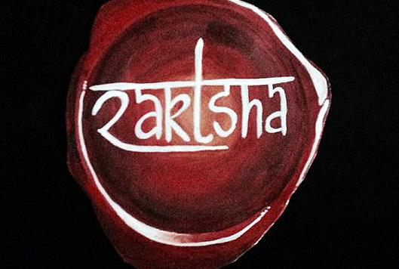

Slide 2
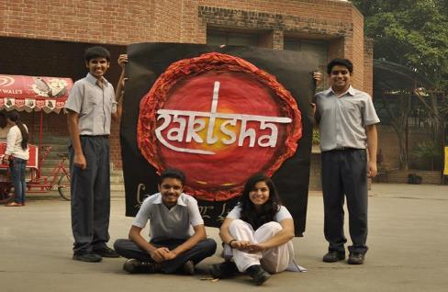
The Changemakers
(L-R Rishab Srivastava, Manav Sehgal, Gaurja Sehgal, Dhruv Khanna)
Founded: September 2014
Raktsha literally means ‘protection of blood’
Objectives: Taking small steps in Delhi NCR to combat anaemia

Slide 3
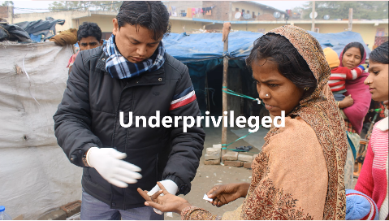
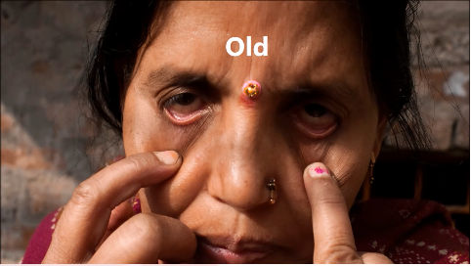
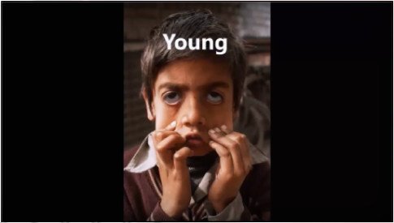
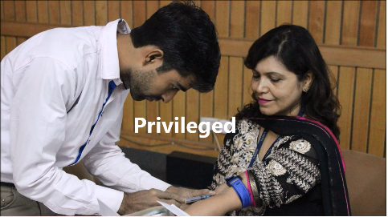
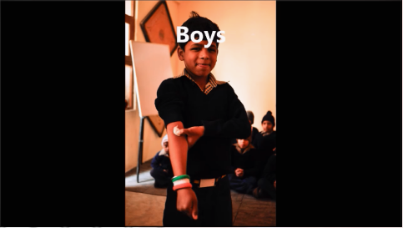
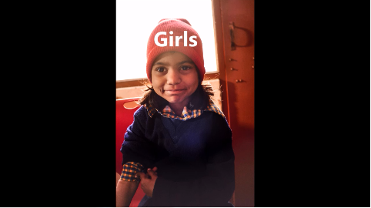
Why we love Anaemia!
Doesn’t discriminate people on the basis of:
Age
Financial background
Gender
Not considered a disease; it has become a way of life
Doesn’t seek attention, silently kills

Slide 4
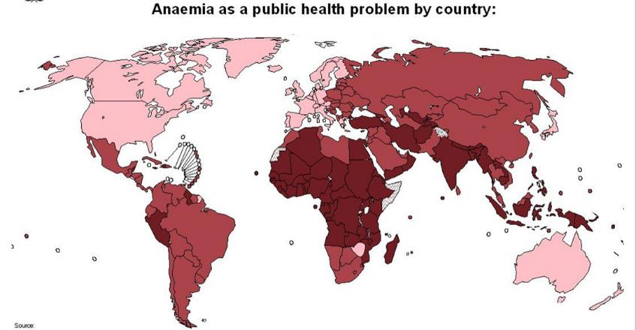
Prevalence all over the world

Slide 5
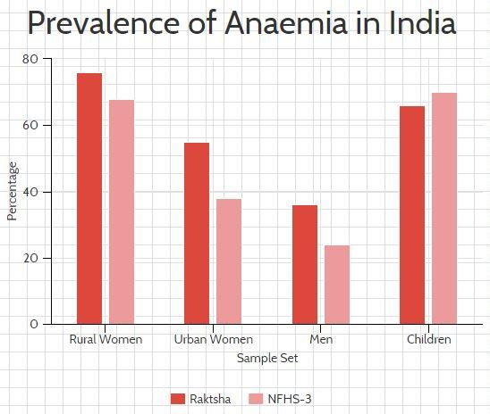

Slide 6
Creating Awareness Across Age Groups
3960 students impacted

Slide 7
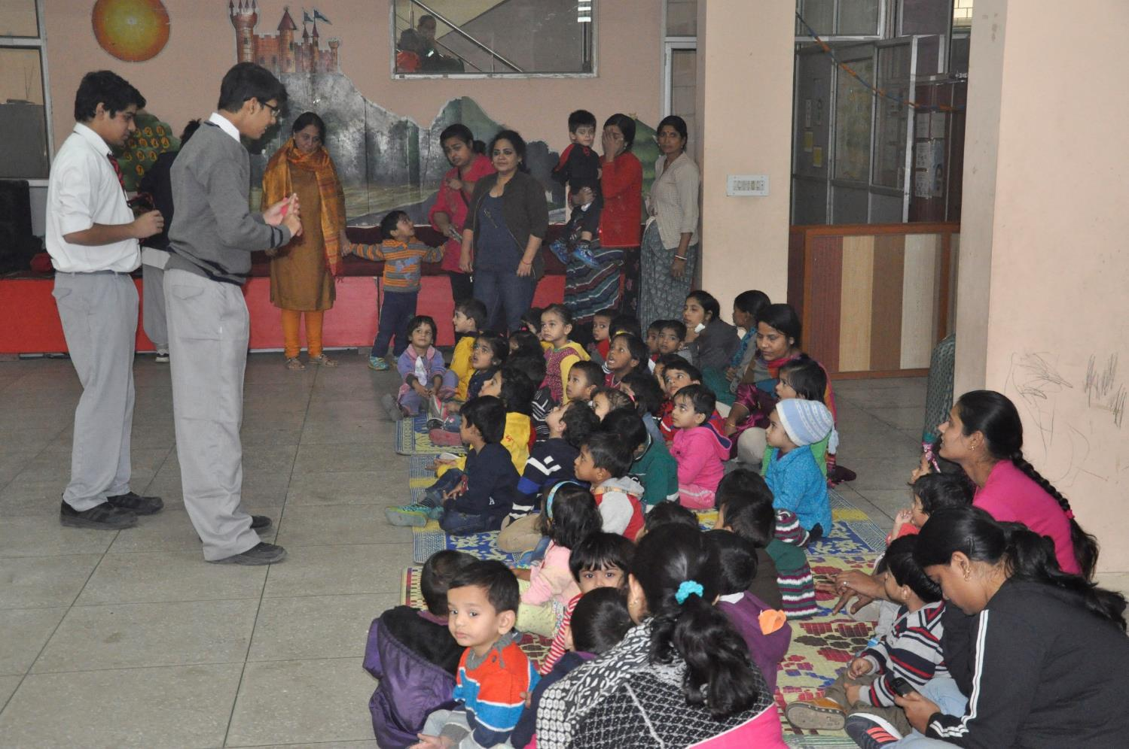
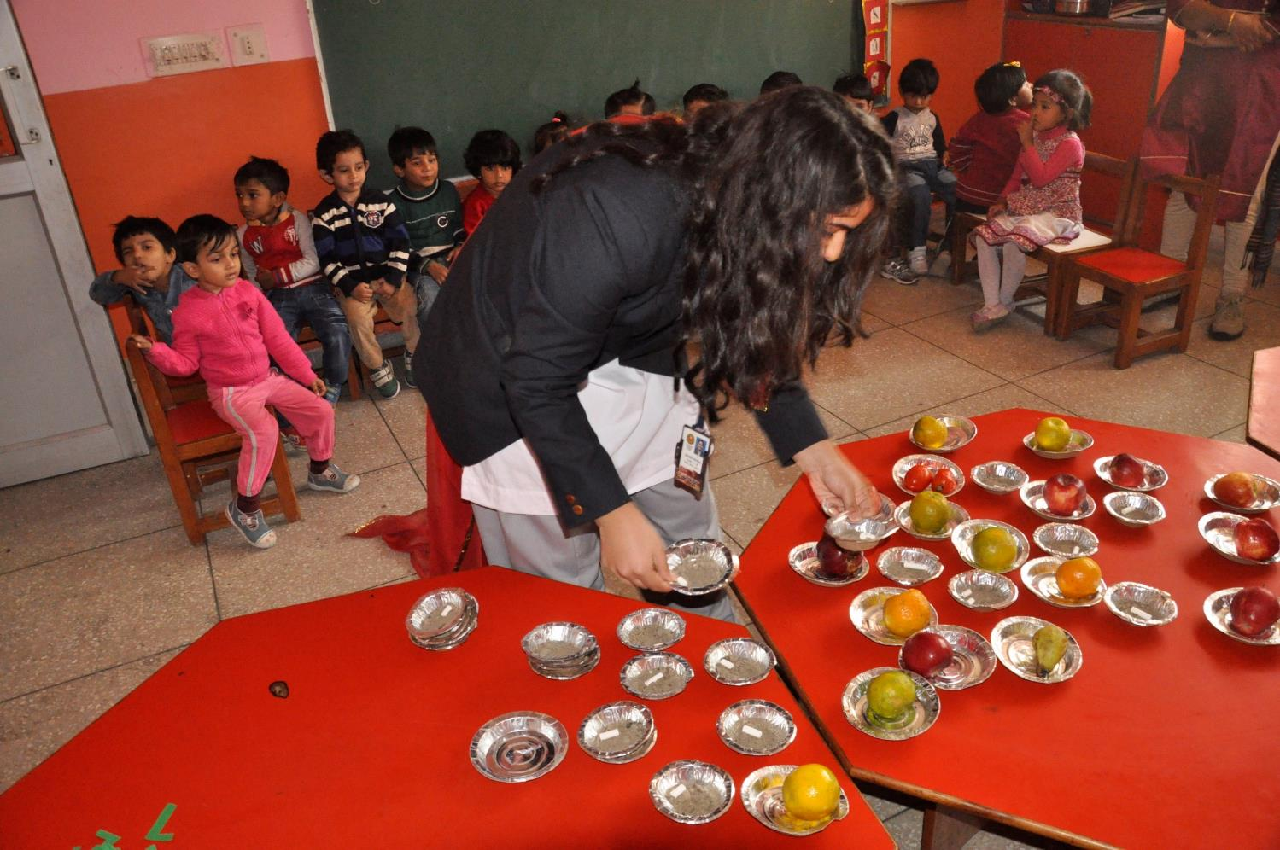
Awareness: 2-3 years
Impact: 200 pre-schoolers educated
Workshop at a playschool to discourage mud and chalk eating
Audio Visual demonstration to reinforce the same

Slide 8
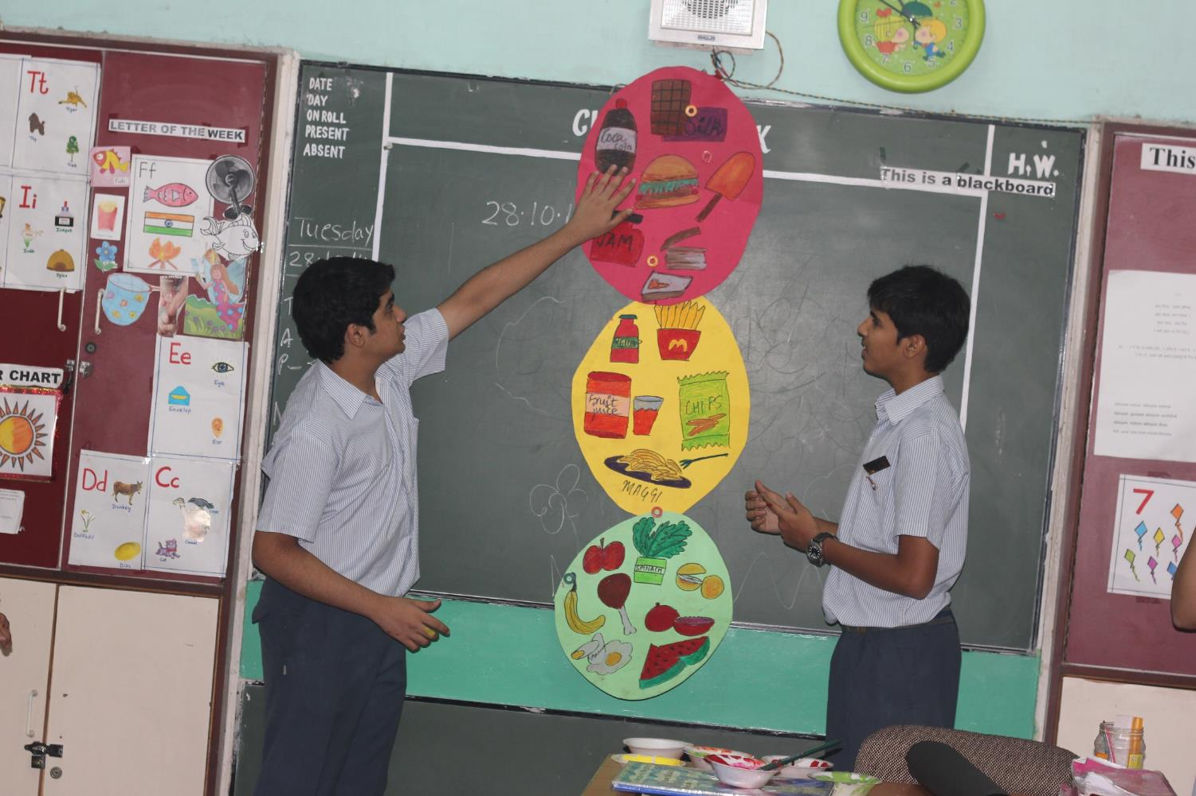
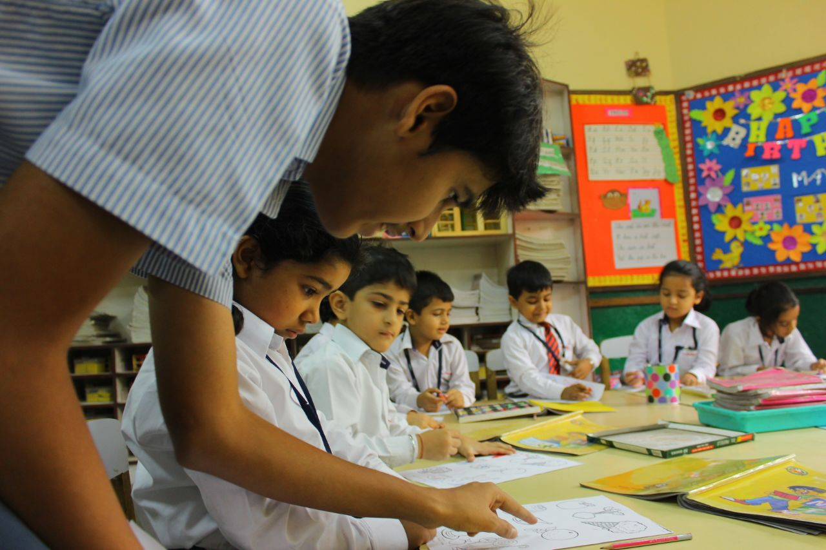
Awareness: 4-10 years
Impact: 1680 children educated
Healthy Traffic Lights
Colouring your way to health
Poster Making
Jumping for Healthy Blood
Poem Recitation
Slogan Writing
Healthy Bites
Throw the Loop
Healthy Basket
Simon Says ‘Combat Anaemia’

Slide 9
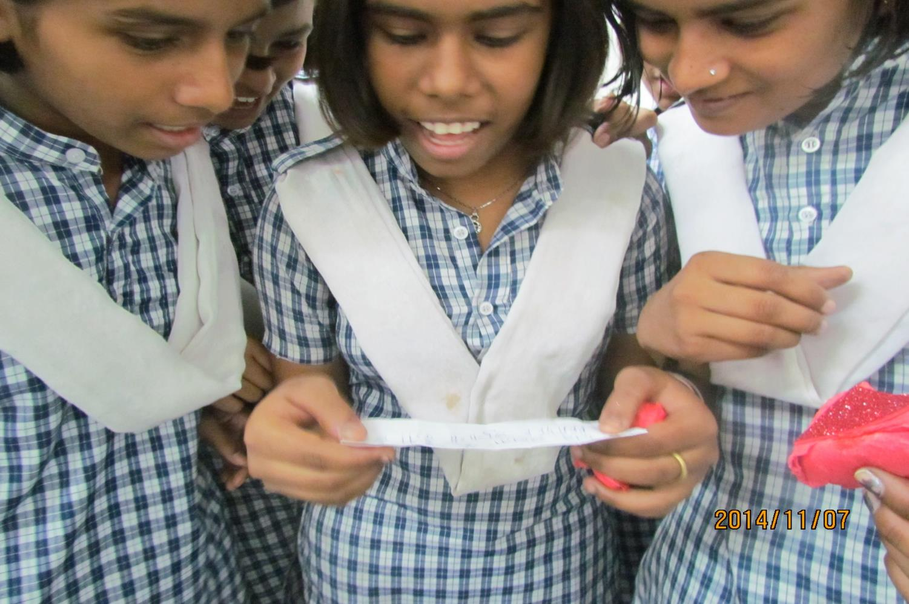
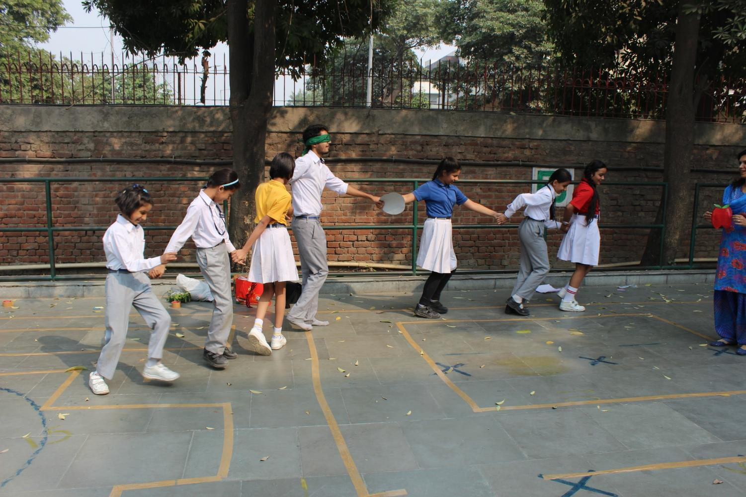
Awareness: 11-13 years
Impact: 600 students educated
Treasure Hunt
The Anaemia Maze
Pop Went the RBC

Slide 10
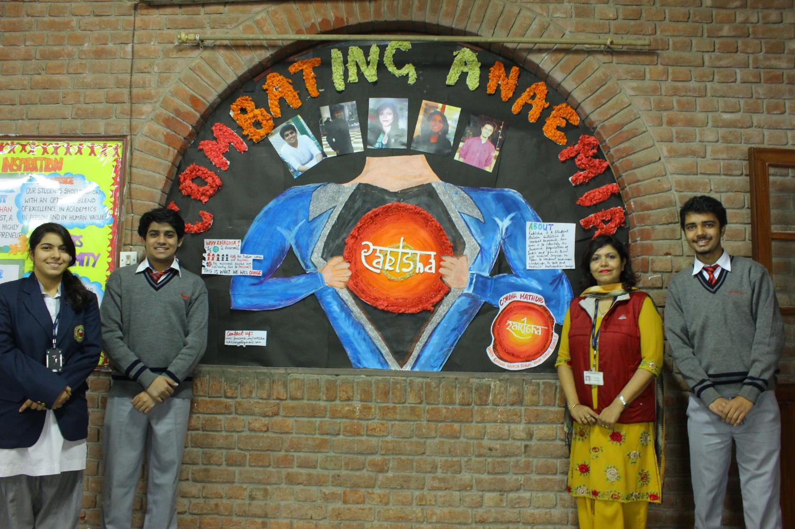
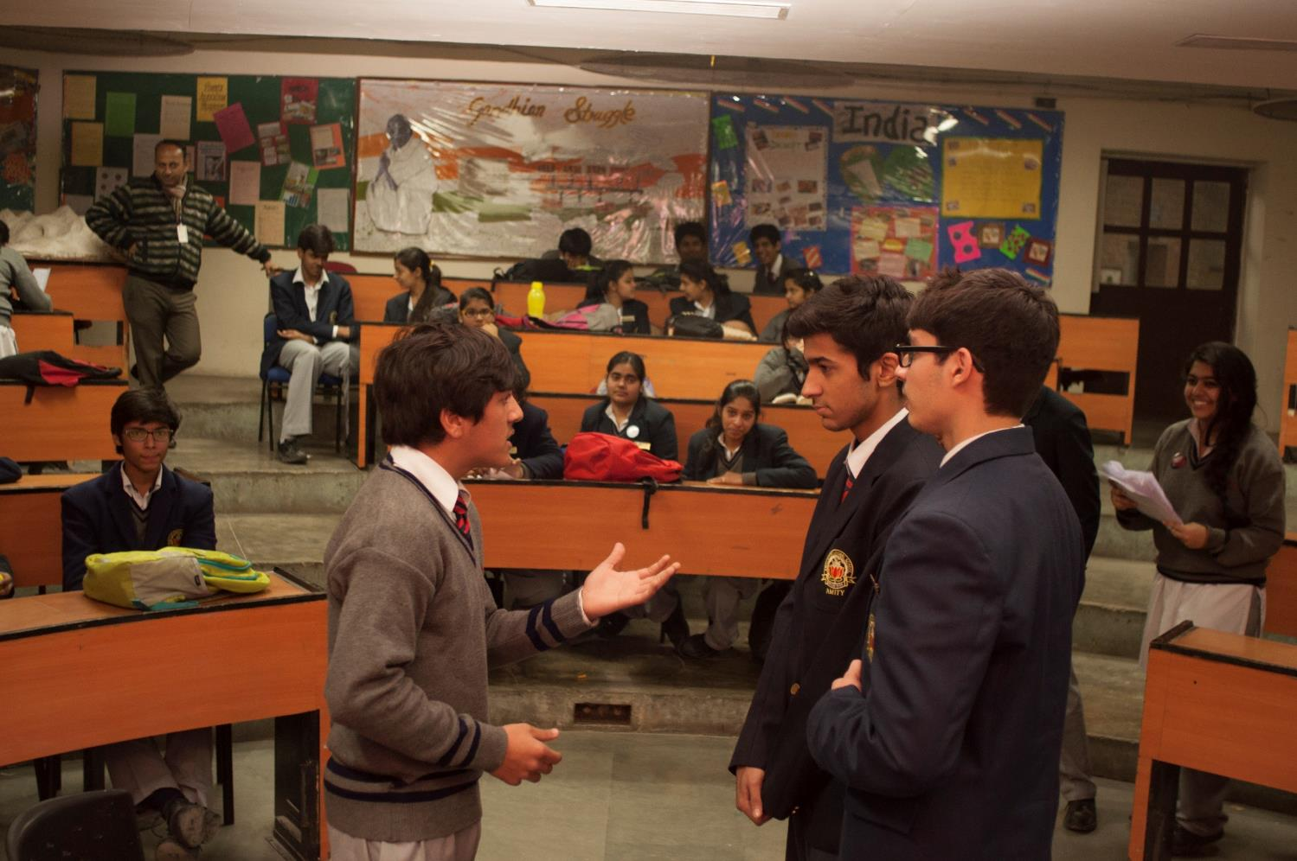
Awareness: 14-15 years
Impact: 100% participation achieved in
9th and 10th grades
1600 students made aware
Raktsha Board
Diary Entry
Jingle Making
Spin a Yarn
Health Quiz
Drop of Blood
Word Search
Group Discussion
Radio Show
Just a Minute
Skit
Role-play
ADZAP

Slide 11
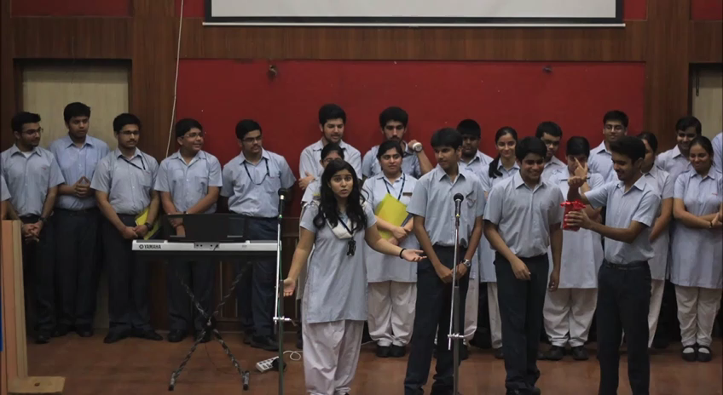
Awareness: 16-18 years
Impact: 420 students of senior school educated
Special Assembly
Bookmark Designing
Spin a Yarn

Slide 12
Reaching Out

Slide 13
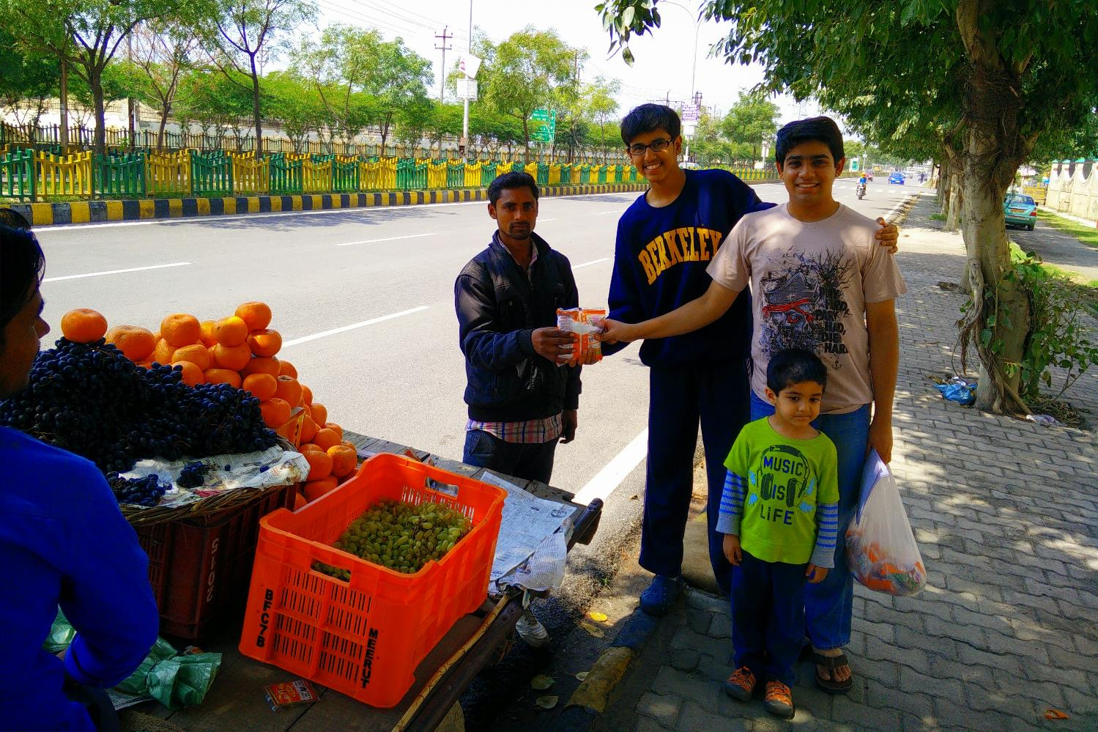
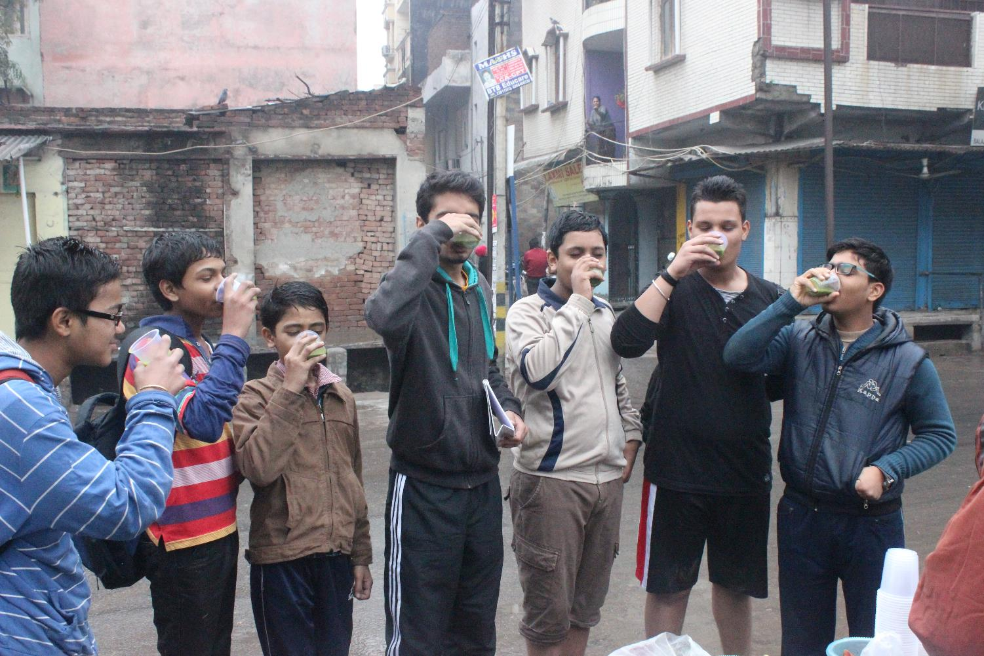
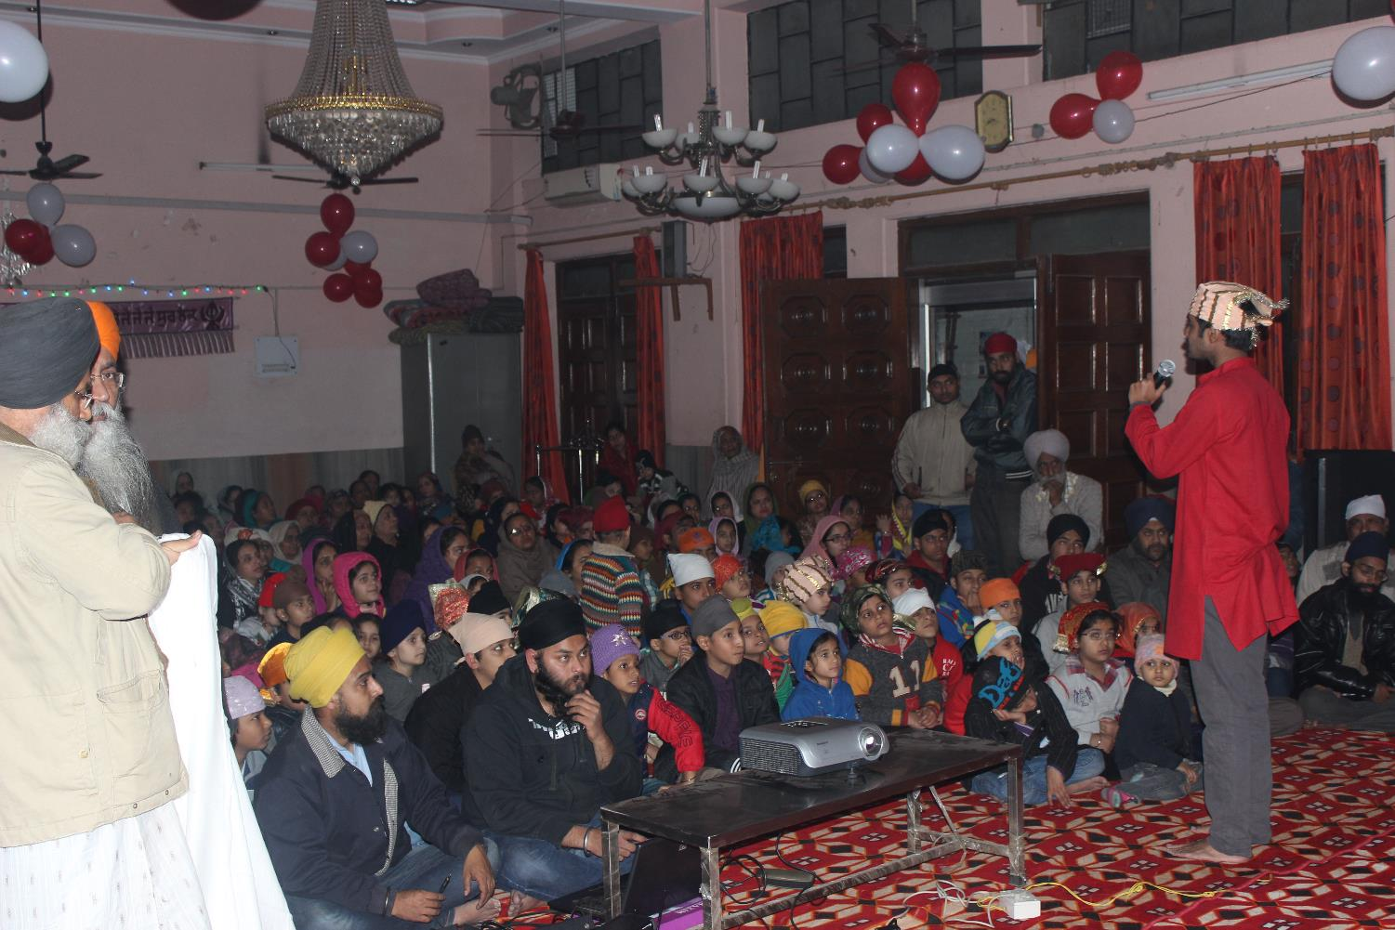
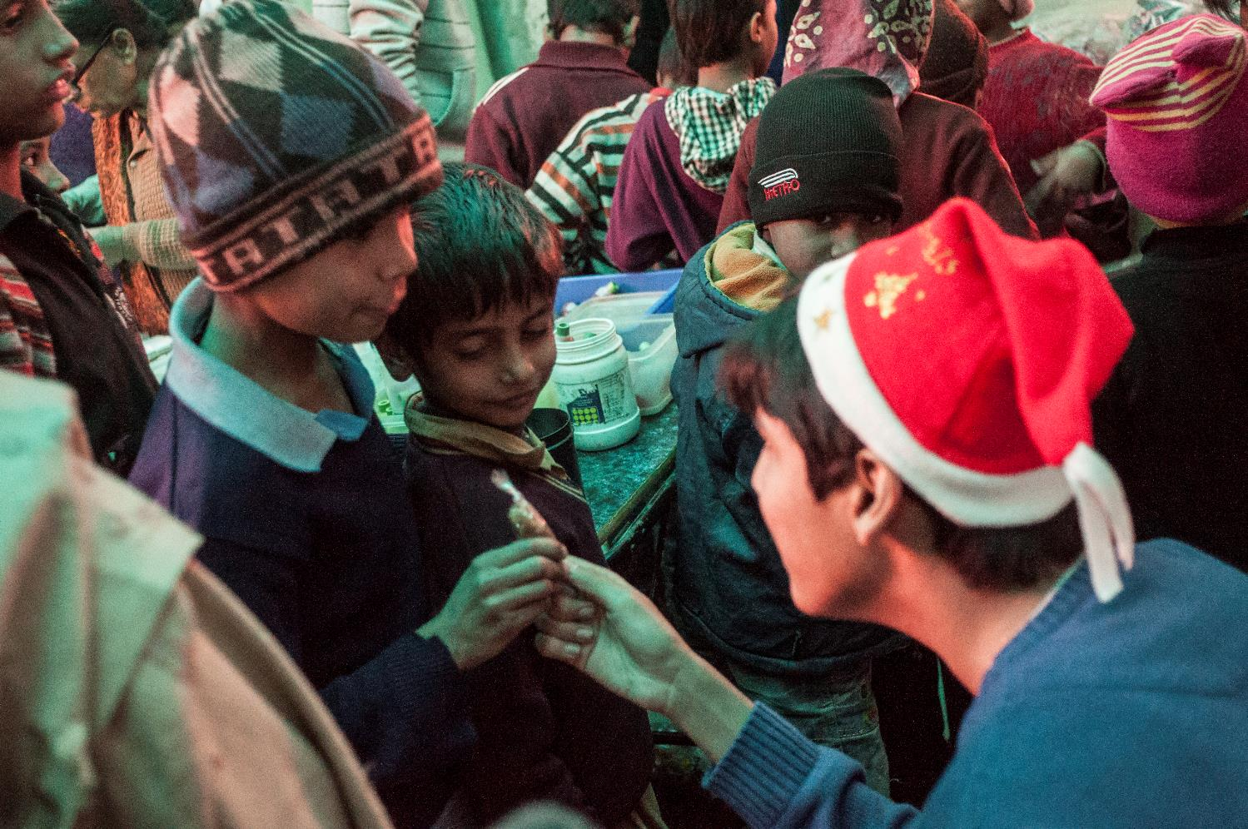
Reaching Out: Community
Impact: 500 flyers given;
50 juices drank;
500+ people educated during festivals
15 kg’s of salt distributed
Wheatgrass Juice Challenge
Salt Distribution
GUDness Bars on Christmas
Iron-rich Langar on Guru Gobing Jayanti
Chikki Distribution on Lohri
Flyer Distribution

Slide 14
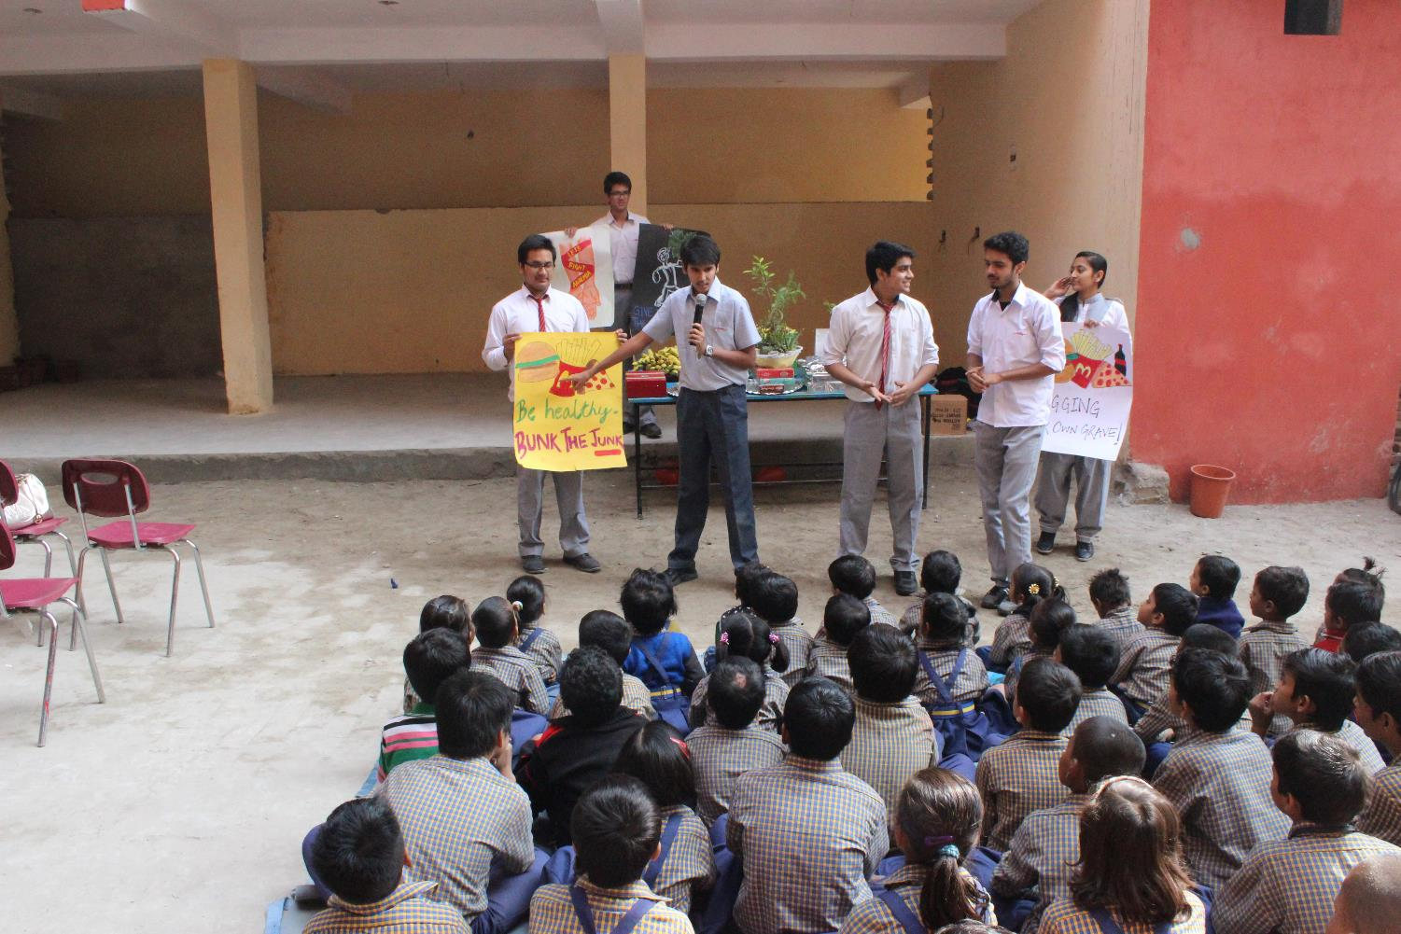
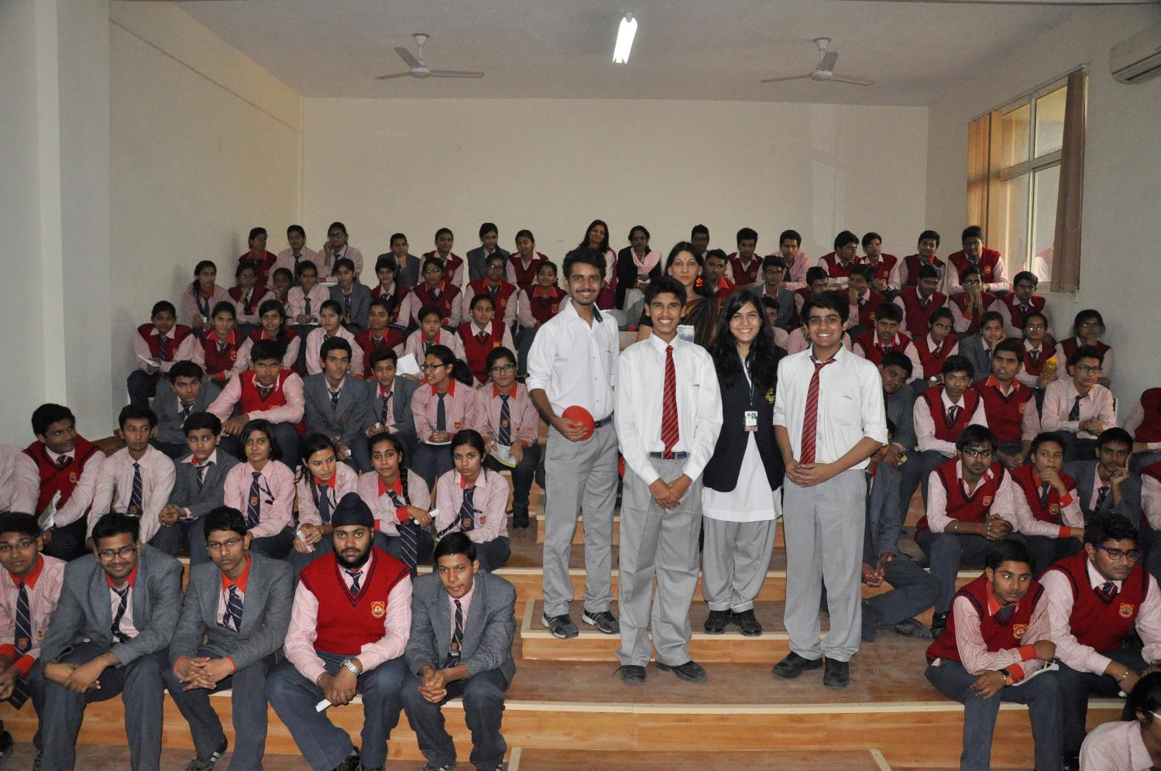
Reaching Out: School
Anaemia Free Children’s Day: Audio Visual Demo and Banana Distribution
Workshop with TOI NIE
Impact: 300 students educated about anaemia and the I importance of healthy eating

Slide 15
Garnering Support

Slide 16
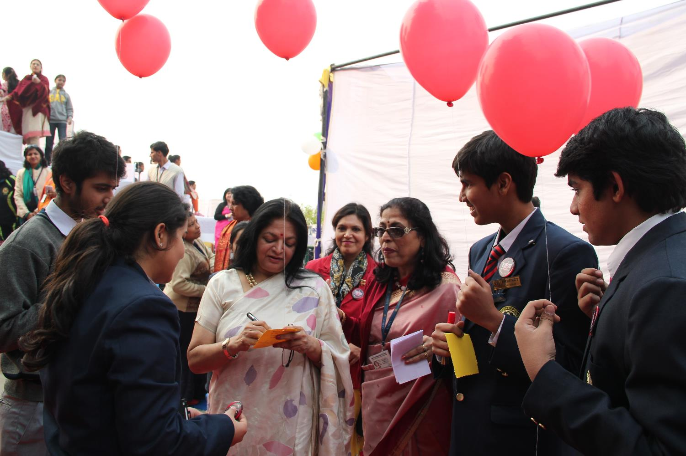
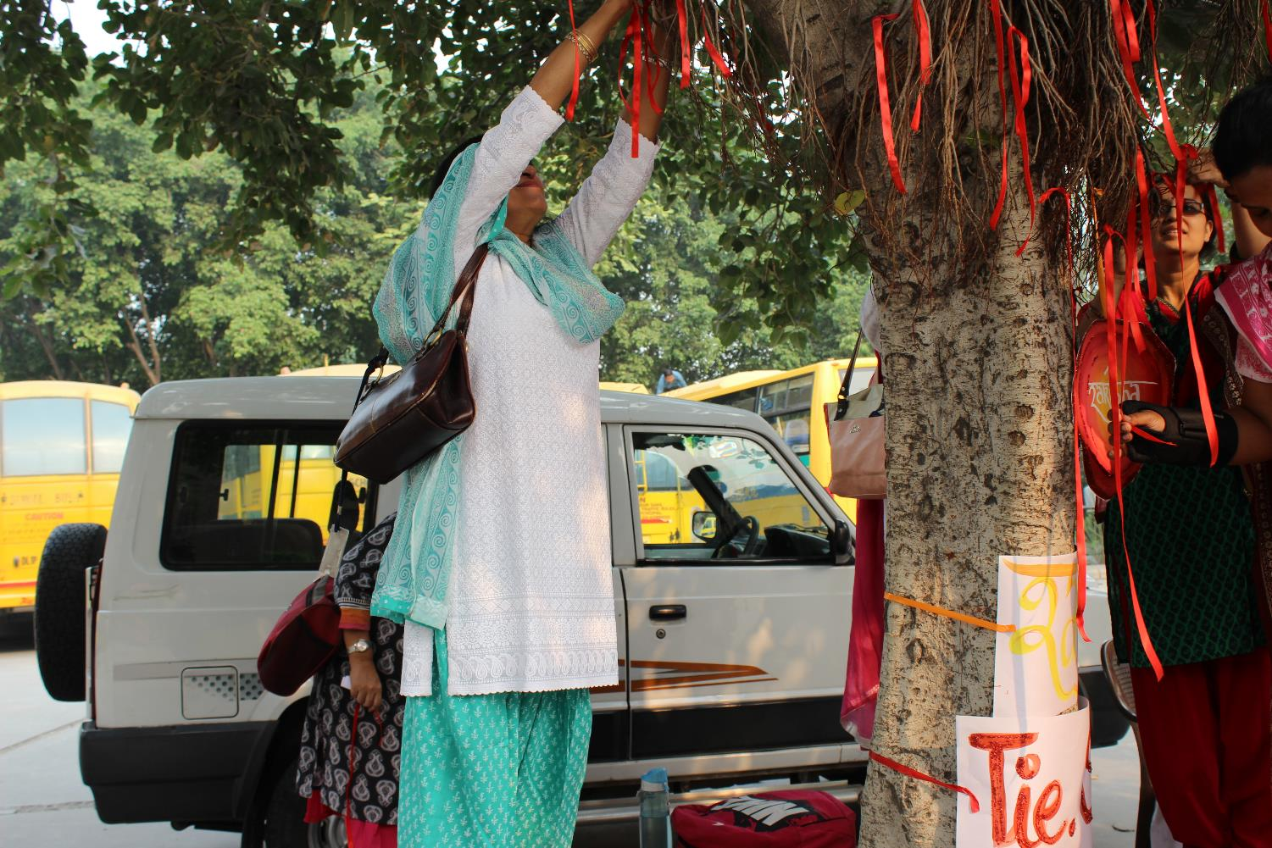
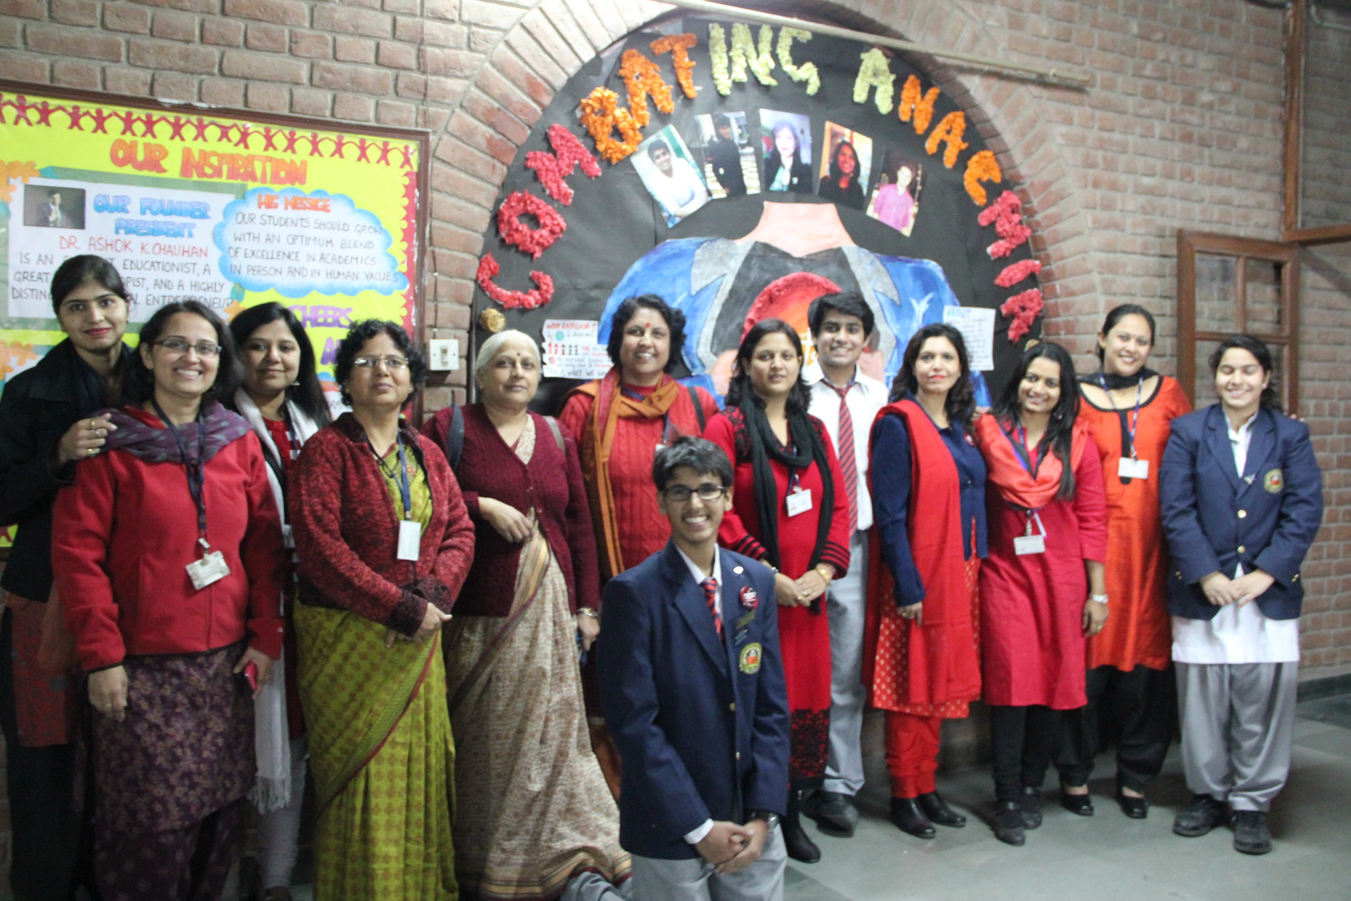
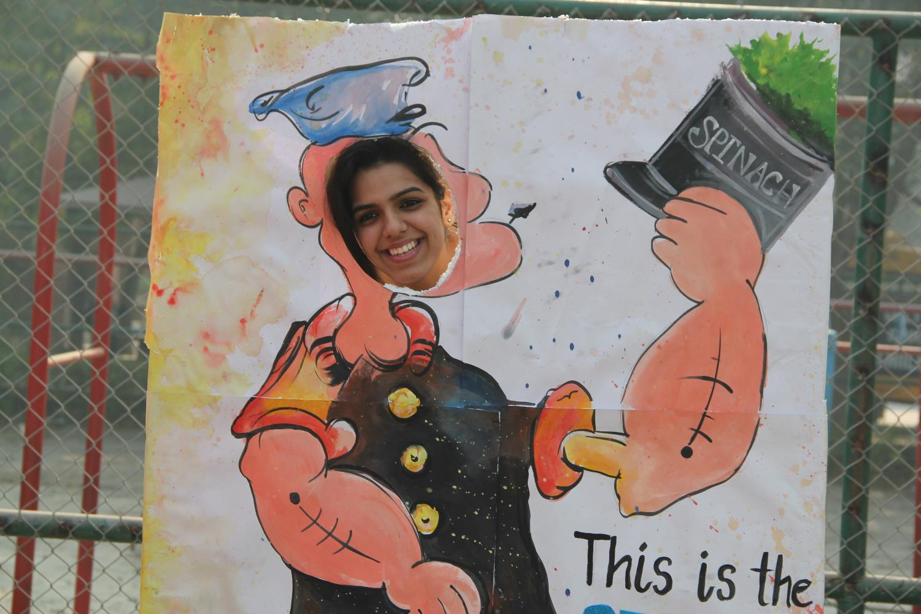
Support: At school
Impact: 1100+ parents and students of all ages h showed support for the cause
100+ teachers involved
Popeye Photo Booth
Helium balloon signatures
Banner Signature Campaign
Tree of Life
RED Day

Slide 17
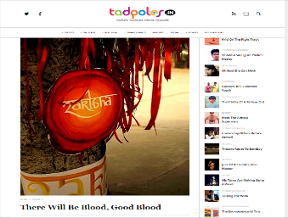
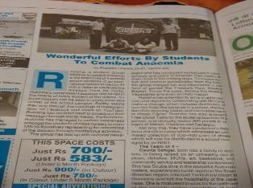
Media Coverage
Tadpoles.com
India’s largest youth magazine
Impact: 15,000+ readers
Samwad
Distributed in 26 sectors of Noida and 31 colonies of South Delhi
Impact: 1.5 lakh readers
HIT 95 FM
Featured 3 times
Impact: 2 lakhs

Slide 18
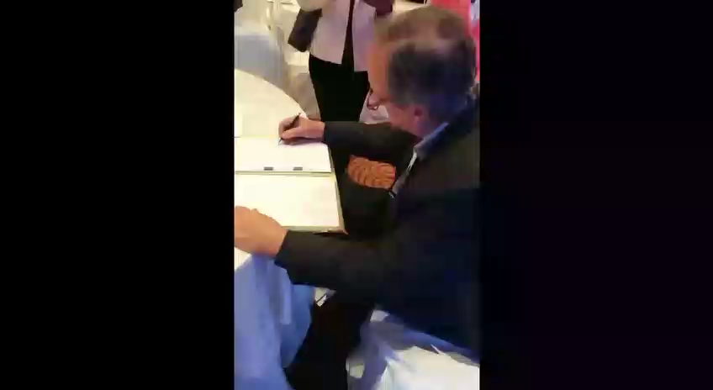
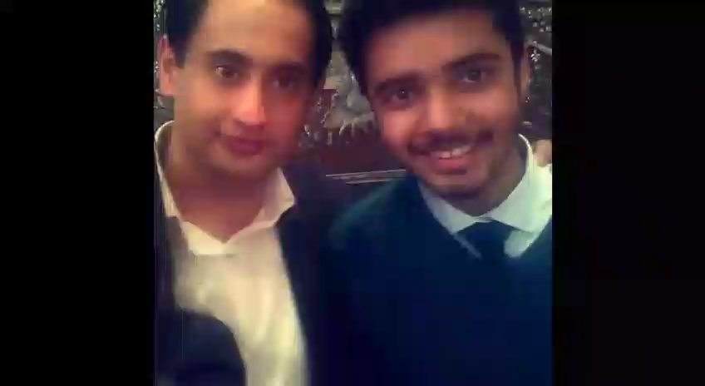
Support: In Community
The team met various luminaries well respected in their fields:
Arnab Goswami
Rahul Kanwal
Barkha Dutt
Mark Tully
Mathew Amroriwala
Rakshanda Jalil and many more
Blessings received: 150

Slide 19





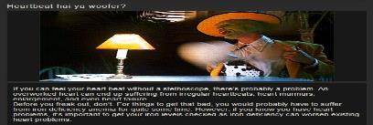
Social Media
Red Alert Challenge
Sarcastic Sundays
Raktsha Calendar
Youtube
Instagram
Imgur

Slide 20

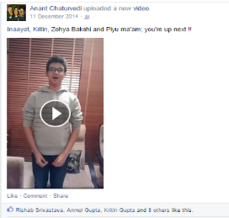
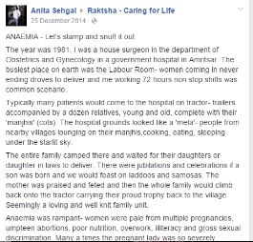
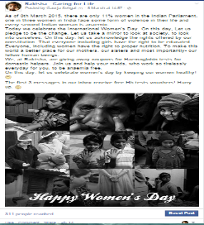
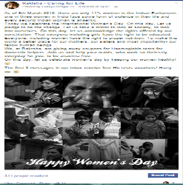
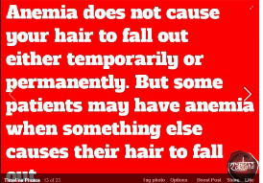
Pop the balloon challenge
Dr. Anita Sehgal Story
DAILY DOSE OF INFO:
Mythic Mondays
Tuesday Talkies
Wholesome Wednesdays
Theraputic Thursdays
Factual Fridays
INSERT DAILY DOSE PIC
RESOLUTIONS PIC
Impact: Counting likes, followers , views and subscriptions = 4000+
Facebook
#AnaemiaAwareness
Free Hb Testing

Slide 21
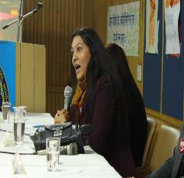
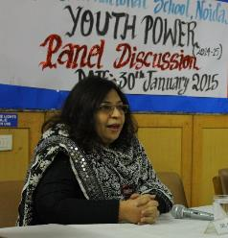
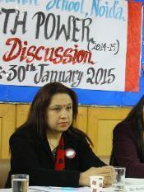
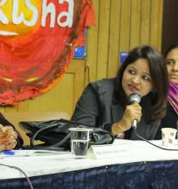
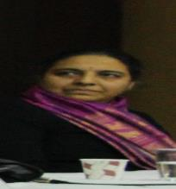
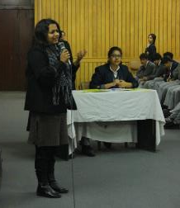
Panel Discussion
Ms. Shikha Nautiyal, Educationist and TOI Consultant
Dr. Anjali Manu, Gynaecologist & IVF Specialist
Dr. Anita Sehgal, Senior Physician
Dr. B Devi Priya , Paediatrician
Dr. Anika Singhal, Pathologist
Ms. Sanyukta Priya, Anaemia Victim

Slide 22
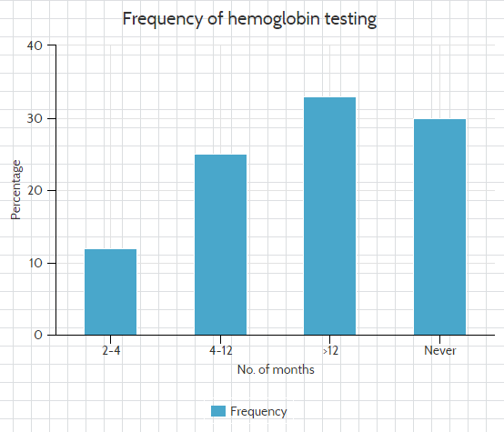
Survey
Important Questions:
Awareness regarding anaemia
Level of fatigue
Onset of symptoms after pregnancy
Restricted meals

Slide 23
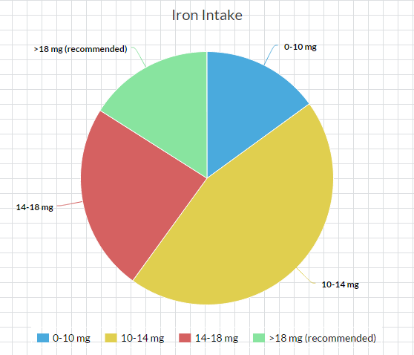

Slide 24
Fundraiser - Raktmasala
Fundraiser unfurled in 4 stages:
Collection of ingredients
Master chef Cook-off
Packaging the goods
Selling the final product
Total Profit= 20 x 115= Rs. 2300

Slide 25
Providing Healthcare

Slide 26
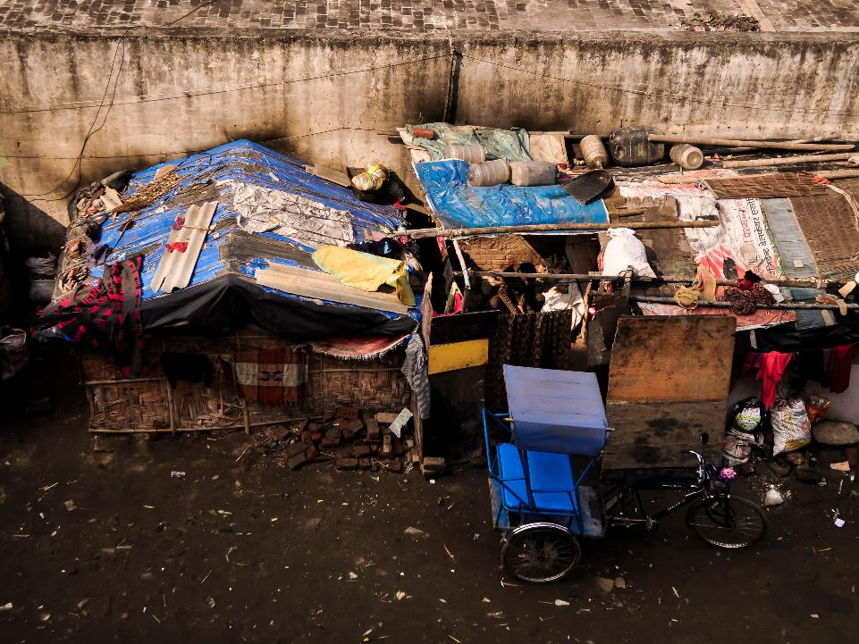
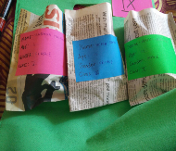
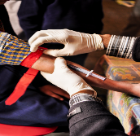

Nithari Village, Sector 30, Noida
Number of Visits : 3

Slide 27




Gheja Village, Sector 93A, Noida Number of Visits:2

Slide 28




Sadarpur Village, Sector 45, Noida
Number of visits: 3

Slide 29
3 Pronged Approach
Diagnosis
Utensils and Footwear
Medical Treatment

Slide 30


Diagnostics: Blood Tests
Impact: 300+ people tested
Blood tests conducted to diagnose the anaemic population
All anaemic people given advice on treatment

Slide 31


Eradication: Deworming & Footwear
Impact: 200+ children dewormed; 250+ children given footwear
Footwear distribution and deworming was carried out to eradicate hookworm disease, a cause of anaemia

Slide 32


Treatment: Kits & Utensils
Impact: 1200+ capsules prescribed;
80 utensils distributed
Personalised kits were given according to people’s diagnosed Hb levels
Iron utensils were also given to enrich their diets with iron

Slide 33

Results

Slide 34
Tangible Impact

Slide 35



Implementing the 3-Pronged Approach in Nithari
Diagnosing the anaemic population
Distributing iron utensils
Prescribing personalised kits

Slide 36





Tangible
83%
2%

Slide 37








Total Reach: 3.8 lakhs & counting

